Slide 1



DRE Manutenção - Copia
View in Power BI
Last data refresh:
03/08/2025 00:18:06 UTC
Downloaded at:
03/08/2025 00:18:51 UTC

Slide 2
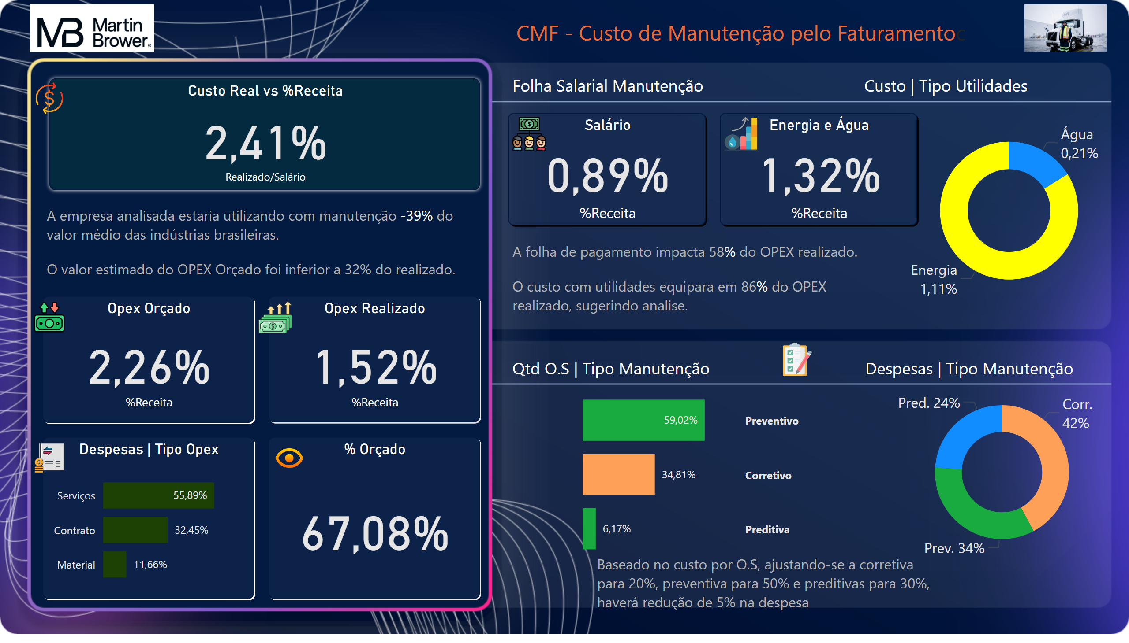
DRE
Notes:
Opex Orçado
No alt text provided
Opex Realizado
No alt text provided
% Orçado
No alt text provided
Custo Real vs %Receita
No alt text provided
Energia e Água
No alt text provided
Custo | Água e Energia
No alt text provided
Classes de Custo
No alt text provided
Salário
No alt text provided
O.S vs Tipo Manutenção
No alt text provided
Despesas | Tipo Opex
No alt text provided
textbox
No alt text provided
textbox
No alt text provided
textbox
No alt text provided
textbox
No alt text provided
textbox
No alt text provided
textbox
No alt text provided
textbox
No alt text provided
textbox
No alt text provided
image
No alt text provided
image
No alt text provided
image
No alt text provided
image
No alt text provided
image
No alt text provided
image
No alt text provided
image
No alt text provided
image
No alt text provided
image
No alt text provided
image
No alt text provided

